Slide 1
Including costs
Per person expected cost of MDA
$$E\left[Cost_{MDA}\right]=Cost_{Trt}+Cost_{FP}×p\left(I=0\right)$$
Per person expected cost of MSAT
$$E\left[Cost_{MSAT}\right]=Cost_{RDT}+Cost_{Trt}×p\left(RDT=1\right)+$$
$$Cost_{FP}×p\left(RDT=1 | I=0\right)+Cost_{FN}×p\left(RDT=0 | M=1\right)$$
(Valle et al., 2016)

Slide 2
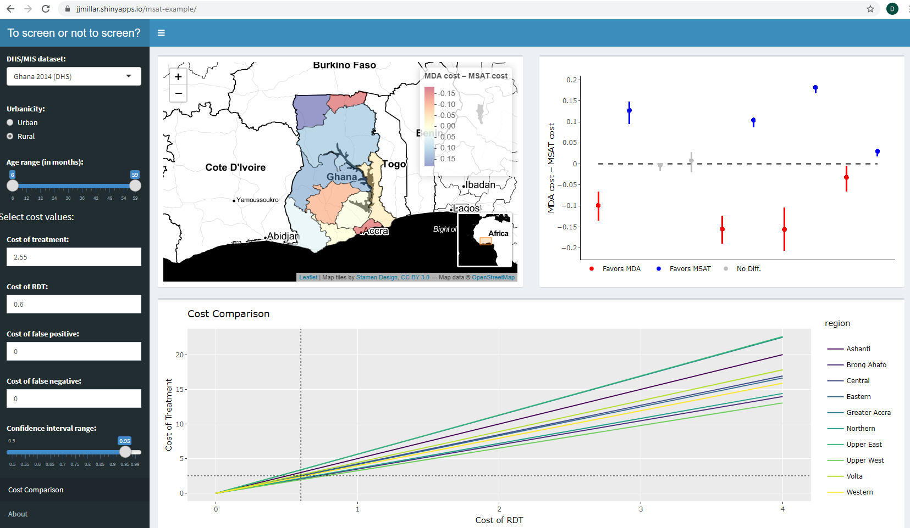
Interactive decision support tool II
https://jjmillar.shinyapps.io/msat-example/
(Millar et al., 2020)

Slide 3
References:
Valle D, Millar J, Amratia P. 2016. Spatial heterogeneity can undermine the effectiveness of country-wide test and treat policy for malaria: a case study from Burkina Faso. Malaria Journal, 15:513.
Millar J, Toh K, Valle D. 2020. To screen or not to screen: an interactive framework for minimizing costs of mass malaria treatment interventions. BMC Medicine, 149.

